Slide 1

>>Inheriting Chinese medicine
follow the developmentrules of TCM,
pass on the essence, adhere to
integrity and make innovations.
promote the introduction
of traditional Chinese
medicine to the world
TCM is a treasure of Chinese
civilization, containing the Chinese
nation's health concept and
practical experience..
attach equal importance
to traditional Chinese
and Western medicine
make full use of its unique
advantages and role in preventing
and treating diseases

Slide 2

>> Inheriting Chinese medicine
>>> Traditional Chinese medicine has its
unique advantages in curing some difficult
diseases that cannot be cured in western China.
>>> The Chinese medicine community should
strive to go abroad and spread the culture,
morality, thinking and concepts of TCM
Chinese
medicine
>>> provide medical and health services with
Chinese characteristics to the people and make
new contributions to human health.

Slide 3


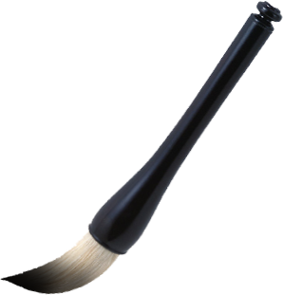

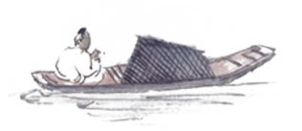
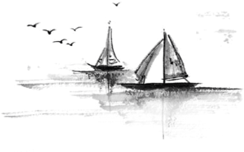
Thanks for lisenting!

